Slide 1
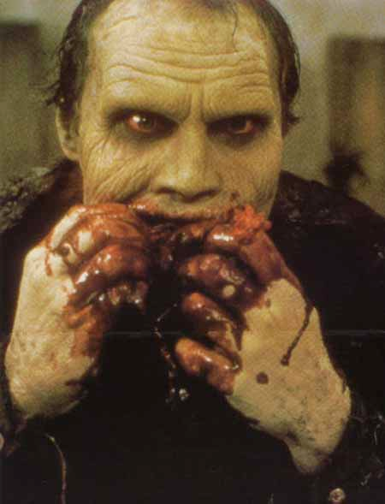
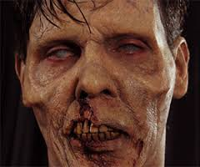
Zombies
GHOSTS of UNC

Slide 2
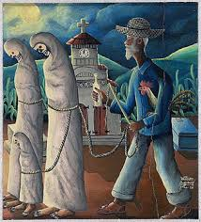
History:
The word “zombie” has its origins in west Africa 19th century from the word nzambi (god/ spirit of dead person), jumbie (Carribean for ghost), and zumbi (fetish).
African religions were brought to what is now Haiti vodun was among them.
Haitian folklore : Bokor (sorcerer who stole either the bodies or souls of the dead and made them slaves for life).
Plantations and slavery were worse than death “to become a zombie was the slave’s worst nightmare: to be dead and still a slave, an eternal field hand”

Slide 3
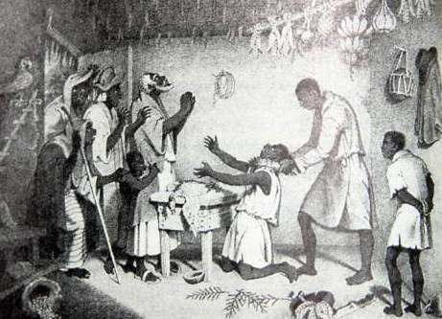
History continued :
Folklore was used to control the population of Haiti, if you wronged the community you lived in fear f being turned into a zombie by the Bokor.
Other cultures reference zombies like the Norse berserkers who too psychotropic drugs that induced hallucinations and sent them into rage when they went into battle.

Slide 4
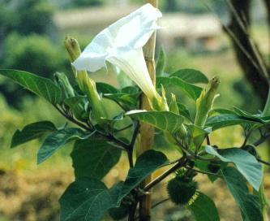
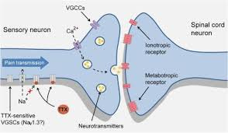
Real case : Mistaken death and Drug induced trance
Poison that make it look like your dead (tetrodotoxin).
Trance like state produced by Datura.
Case Study: Clairvius Narcisse

Slide 5
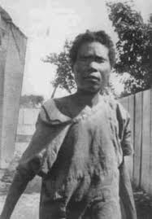
Clairvius Narcisse

Slide 6
What would a zombie look like?
Not Undead like on shows like walking dead or night of the living dead.
More like increased aggression and hallucinations.
Possible trance like states where they are easy to control.

Slide 7
Government:
Would like to believe that the government would not use weapons against us .
America might be safe however what about other countries that demand control or their people.
PCP in Vietnam
Viruses that attack the brain

Slide 8
Can zombies be created?
In my opinion yes.
If hormones can be controlled then aggression can be controlled. Pathways in the brain can be altered by drugs, hormones, chemicals or by destroying pathways in the brain.
Viruses that attack the brain like rabies.

Slide 9
The Brain

Slide 10
Brain pathways for aggression

Slide 11
Everyday ways to protect yourself
Be aware of your environment
Be aware of people around you
Make an emergency plan with your family

Slide 12
Advanced planning :
Gather supplies make an emergency list of stockpiled items
Have a family plan
Learn survival techniques/ read about surviving in the wild
Learn first aide
If there is ever a SHTF moment then avoid highly populated areas

Slide 13
National geographic :
https://www.youtube.com/watch?v=orYwTGuUsy4

