Slide 1
Time Travel: Interesting Cases and solid science

Slide 2
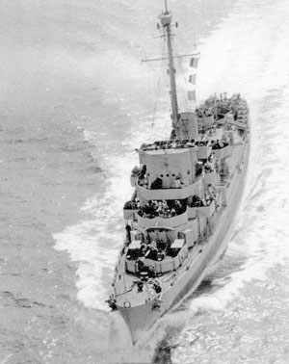
THE PHILADELPHIA EXPERIMENT
U.S.S. Eldridge at sea April 25th, 1944
When the actual test was put into motion, a NUMBER of unexpected and bizarre side effects occurred. As the electromagnetic field increased in strength, it began to extend as far as 100 yards out from the ship in all directions, forming a large sphere. Within this field, the ship became fuzzy and indistinct, and a greenish haze formed around the vessel, obscuring it from view. Eventually, the only visible object was the outline of the hull of the Eldridge where it ENTERED the water. Then, to the amazement of onlookers, the entire ship vanished from view.
It was at this point (the vanishing of the Eldridge) that the true power of the electromagnetic field that had been created was revealed. The Eldridge had not only vanished from the view of observers in Philadelphia, it had vanished from Philadelphia all together! The ship had been instantly transported several hundred miles - from Philadelphia to Norfolk, Virginia. After a few minutes, the ship once AGAIN vanished, to return to Philadelphia.
To the Navy, the test had succeeded beyond their wildest dreams. Not only had they rendered a ship invisible to radar, they had made it optically invisible as well, not to mention causing the vessel to teleport hundreds of miles in a matter of minutes. For the crew, however, the trip had been a nightmare.

Slide 3
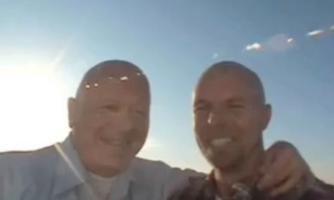
Other examples of time travel
https://www.youtube.com/watch?t=17&v=qBUv4j3DINE

Slide 4
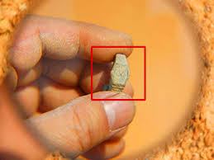
More Examples of time travel
https://www.youtube.com/watch?v=xZeFMjRnRck
http://paranormal.about.com/od/timeanddimensiontravel/a/time-travelers_2.htm

Slide 5
Evidence and Science behind time travel
https://www.youtube.com/watch?v=nJqRF6r0cXY

