Slide 1
Divination
Ghosts of UNC

Slide 2
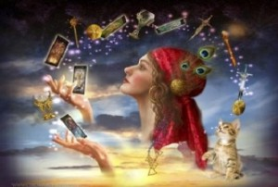
Divination:
1: the art or practice that seeks to foresee or foretell future events or discover hidden knowledge usually by the interpretation of omens or by the aid of supernatural powers
2: unusual insight : intuitive perception

Slide 3
A Brief History:
There are several systems in particular that are rooted in history and are widely used throughout the world today: Astrology, Numerology, I Ching, Tarot and Runes.
I Ching has been around for 3,000 years ; it arose around the same time Taoist and Confucian philosophy (mysticism).
Astrology and Numerology has been around since the human race noticed celestial bodies (this was popular in Greece, Rome, China, and Egypt).
In every part of the world Runes are found (oldest runes found to date back to 150 AD); more popular in Nordic, Germanic, and Celtic regions.
Tarot was practiced since the 9th century (1045 AD) and became more popular when the printing press was invented.
Palm Reading: Has been cited in old text such as Hindu and Hebrew religious texts.

Slide 4
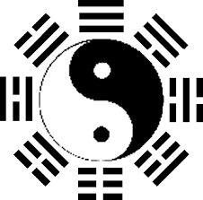
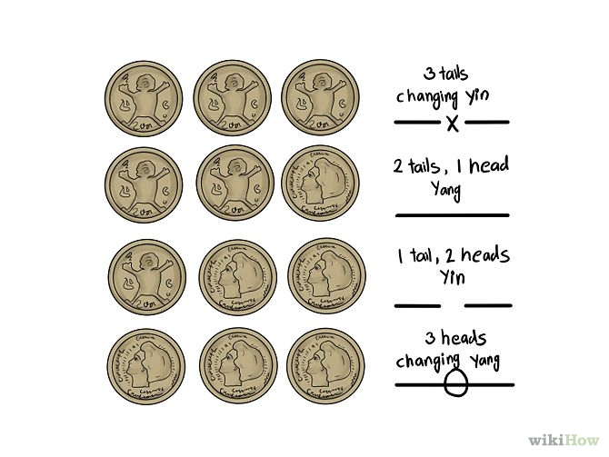
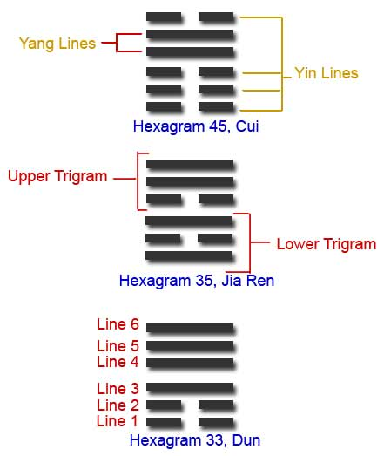
I Ching:
Is a book of “poems” and Archetypes that was written by Emperor Fu His
You interpret hexagrams that lead to clarification of questions you have.
Interesting forum od divination because it focus on the YIN and Yang of the universe.
Started to grow popular in the west in the 1960 when eastern philosophy was becoming more accepted.

Slide 5
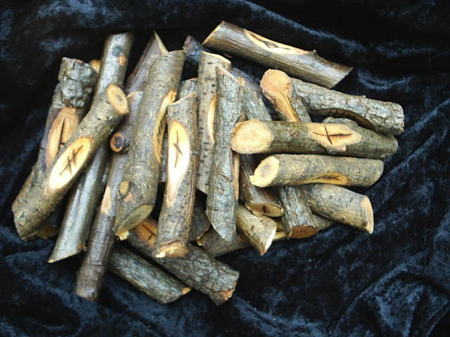
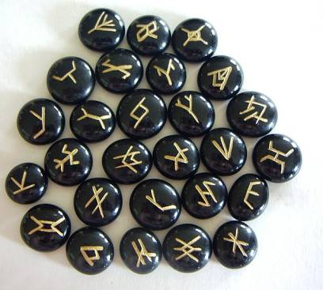
Runes:
Made of stone, wood, or bones.
Symbols represent archetypes that tell stories (much like the I Ching).
Sometimes used for protection.

Slide 6
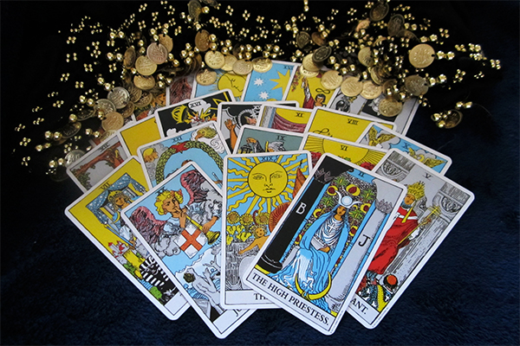
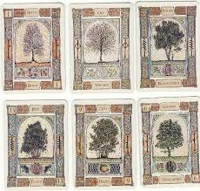
Tarot:
Around since the 9th century.
Cards ( of every kind have always been used for divination).
Tarot popular with the upper class in France and Italy in the 1400’s
Like I Ching and Runes it uses Archetypes to give insight on the future.

Slide 7
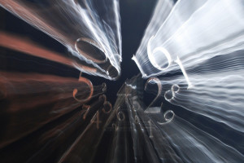
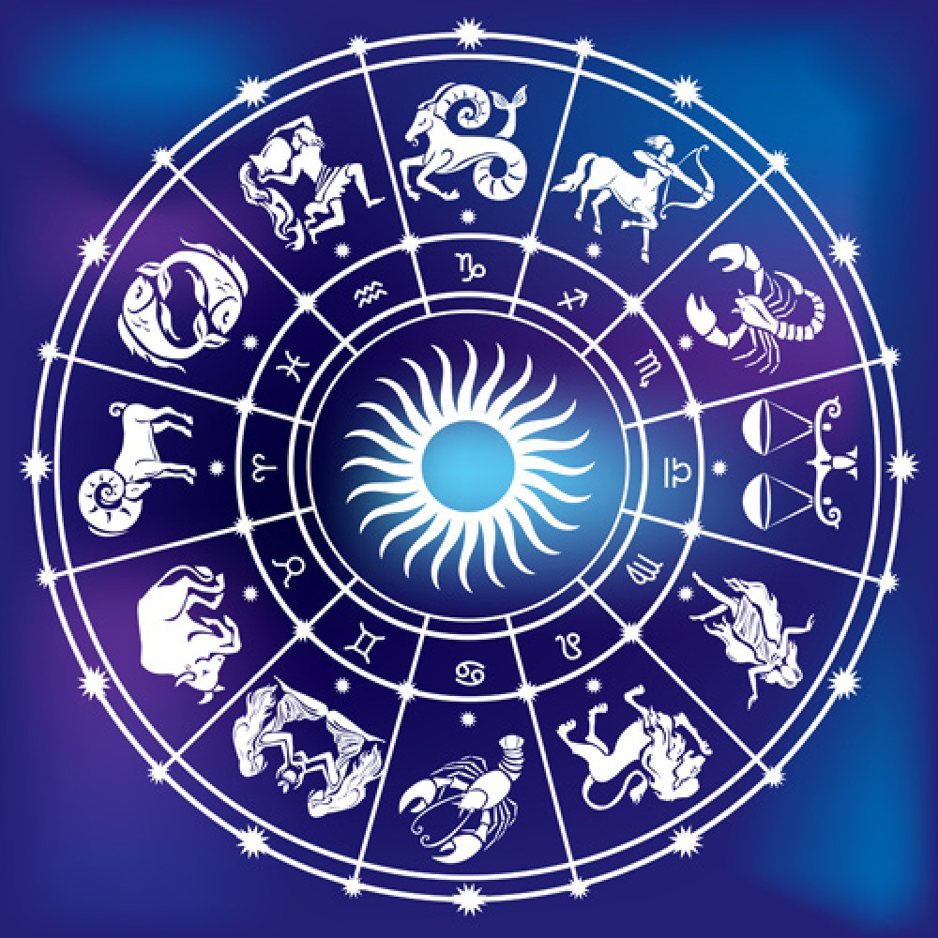
Astrology and Numerology:
Personality traits that have an impact on the way we are seen by other people.
“stars” we come from the stars. As I am sure many of you have heard Neil Degrasse Tyson and Carl Sagan say we are made of “star stuff”
Based on movement of the stars and other celestial bodies in our solar system.
Numerology is based on the idea that everything in the universe is both made up of and affected by numbers. Numerology uses both the letters in your name (which are first translated into numbers) and the numbers in your birthdate to give indications of your true nature, your desires and your destiny. In numerology, the numbers both in your name and in your birthdate are added together to arrive at a single digit that is then analyzed to reveal a meaning. By using your full name, the separate parts of your name and your birthdate in various combinations much can be revealed about who you are and who you are meant to become.

Slide 8
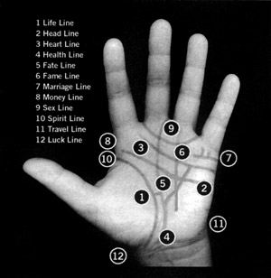
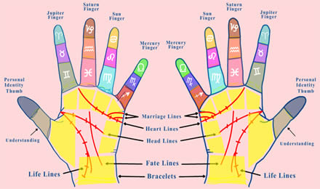
Palm Reading:
Reading the lines, bumps, shape, and callouses on hands.
Can determine traits of the person.
Can be used to inform the person of there potential future
Use dominate hand.
Finger Prints.

Slide 9
Thoughts:
How does everyone feel about Divination?
Would you want to learn ?
Would you want a reading?
Would you be interested in getting an individual to speak o this?

